Slide 1
Descriptive Data Mining Campus Recruitment Analysis
By
Divya Dongala
Pragati Gupta
Data Mining Project

Slide 2
Descriptive Data mining
Finds data describing patterns.
Determine the similarities in the data.
Find existing patterns.
Methods:
Association Rules
Sequence Mining
Cluster Analysis

Slide 3
Campus Recruitment Analysis K means Algorithm
This Analysis contains Student unique Id, School Percentage, Degree details and Work experience as well as salary detail.
In this Analysis we use K means Algorithm (Clustering Analysis) to analyse various pattern amount each columns.Where each cluster is represented by the center of the cluster
Step1: Select / Partition objects into k nonempty subsets.
Step2: Select the Centroids/mean points ( Recheck with Elbow method)
Step3: Assign each object to the cluster with the nearest seed point.
Step4: Repeat Step 2, till we gets new assignment.

Slide 4
Data Set (pre-processed)
IntroDuction Of data Set
This is a pre-processed database.(From the final result set of assignment 1)
This Data is collected from various websites of a university which include data from many department like Arts, Scinece, Marketing anf Fincace, Marketing HR. (downloaded from Kaggel).
DataSet
Target Objects
Case1: MBA_p (MBA percentage) and Salary
Case2: SSC_P(senior secondary percentage) and Salary
Case3: Status(Placement status first convert from categorical data to numerical data) and aggerate School Percentage

Slide 5
K Mean Clustering
Process
k initial "means" are randomly generated within the data domain
k clusters are created by associating every observation with the nearest mean. The partitions here represent the in the scatter plot diagram generated by the means.
The centroid of each of the k clusters becomes the new mean.
Steps 2 and 3 are repeated until convergence has been reached.
Reverify the k value from elbow method.

Slide 6
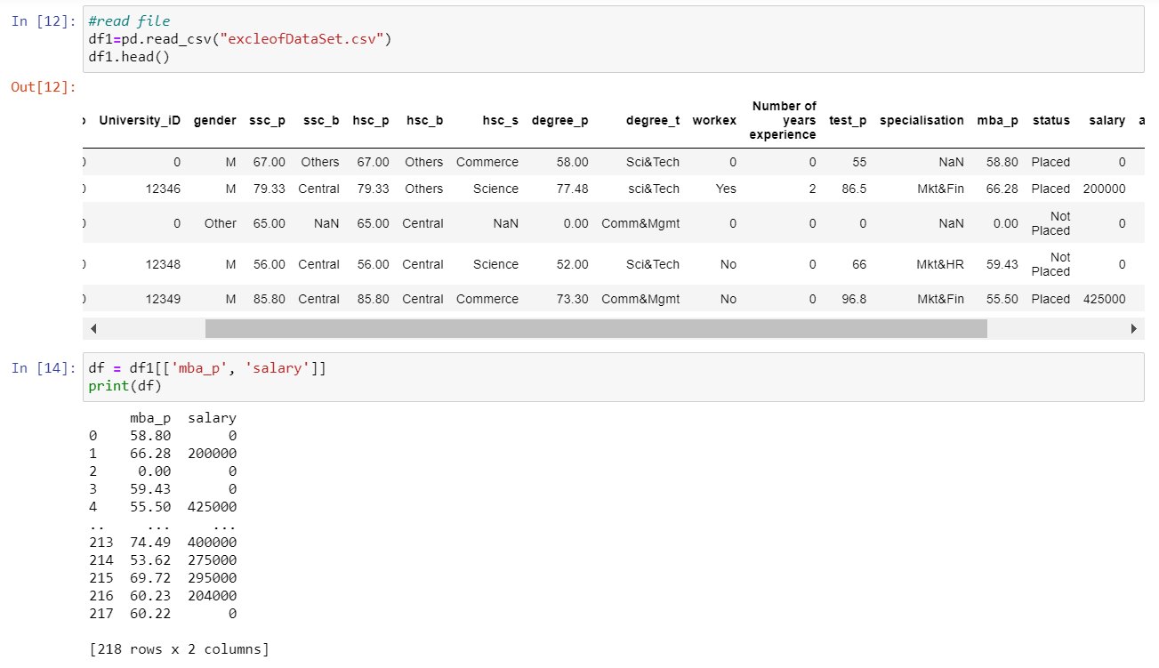
Case1: MBA_p (MBA percentage) and Salary
Columns: MBA_Precentage and Salary

Slide 7
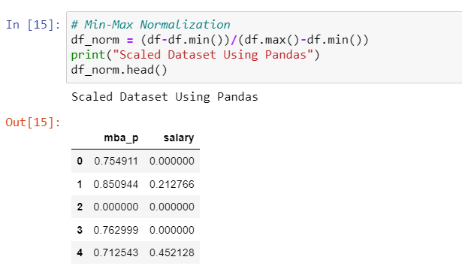
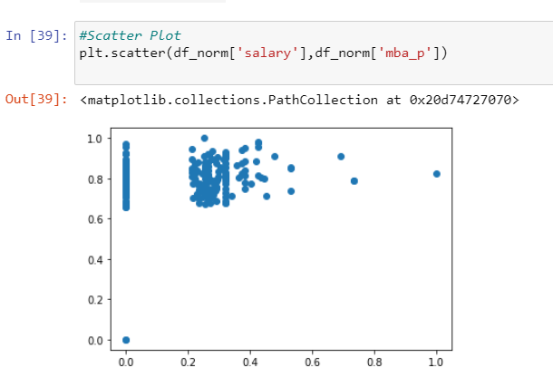
Case1: MBA_p (MBA percentage) and Salary
Normalization of columns
Scatter plot for the normalized columns

Slide 8
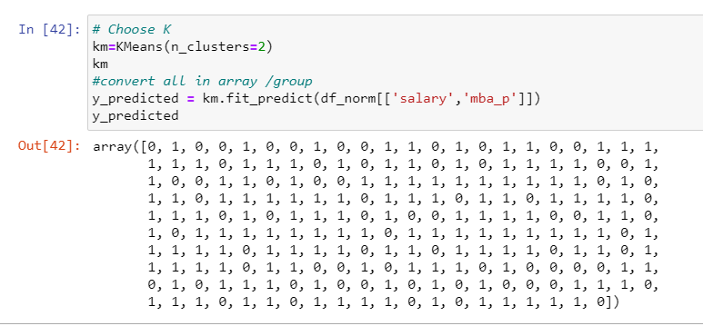
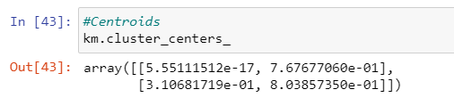
Case1: MBA_p (MBA percentage) and Salary
Divide clusters and convert all in array or group
Identify centroids

Slide 9
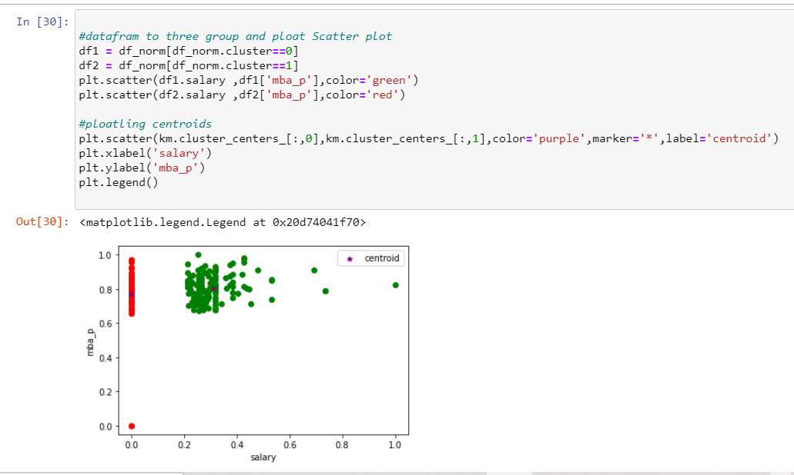
Case1: MBA_p (MBA percentage) and Salary
Plot scatter plot for all data frames including centroids

Slide 10
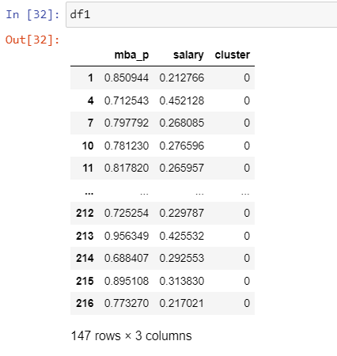
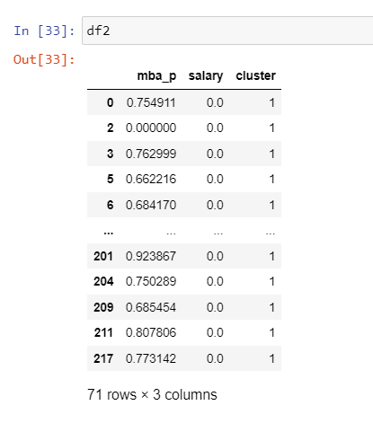
Case1: MBA_p (MBA percentage) and Salary
This data frame with cluster 0
This data frame with cluster 1

Slide 11
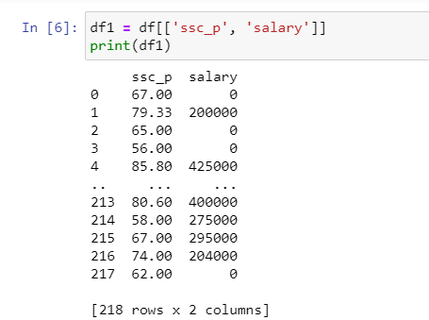
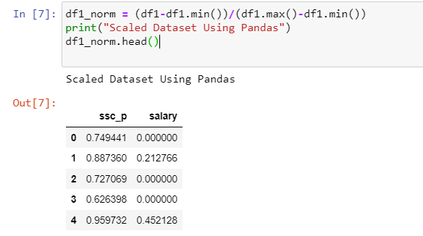
Case2: SSC_P(senior secondary percentage) and Salary
Case2
Columns: SSC_Precentage and Salary
Normalization of columns ssc_p and salary

Slide 12
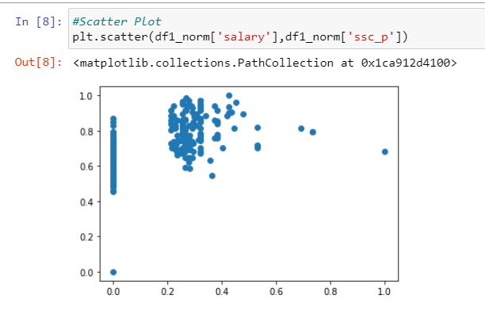
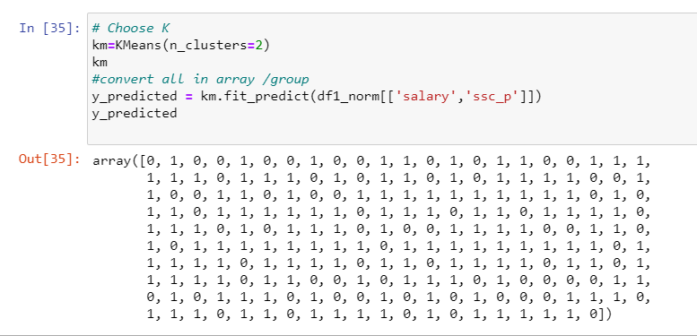
Case2: SSC_P(senior secondary percentage) and Salary
Case2
Plot normalized columns salary and ssc_p
Divide clusters and covert the values to array

Slide 13
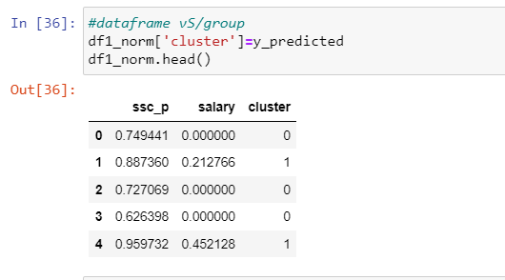
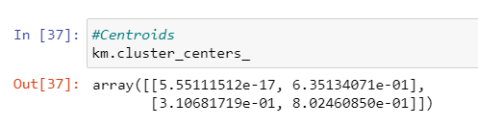
Case2: SSC_P(senior secondary percentage) and Salary
Case2
Showing the clusters for each row values
Identify the clusters

Slide 14
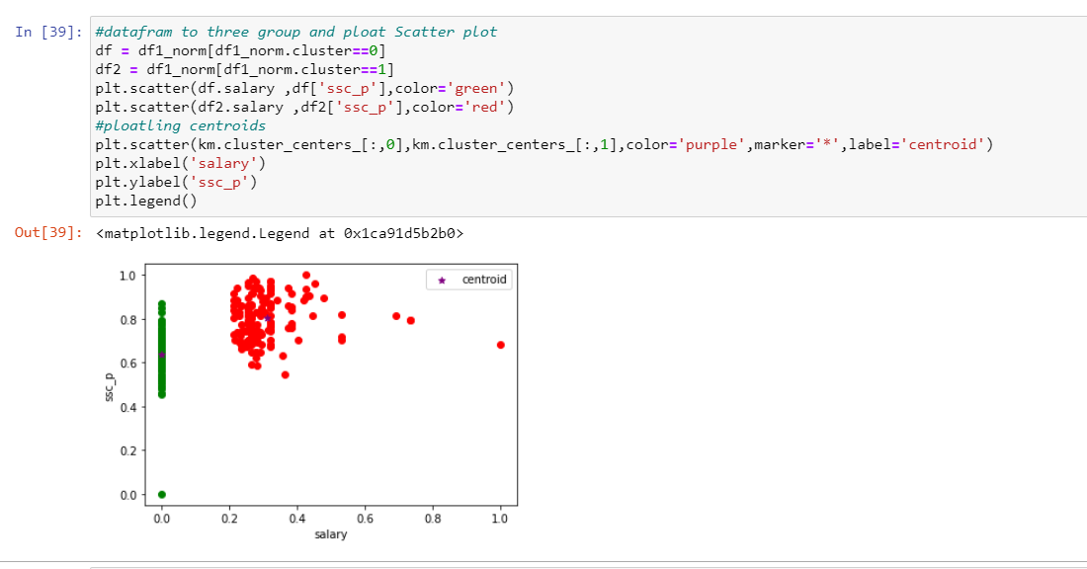
Case2: SSC_P(senior secondary percentage) and Salary
Plotting the data frames and centroids with labels

Slide 15
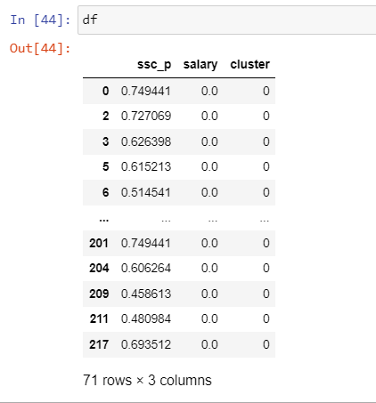
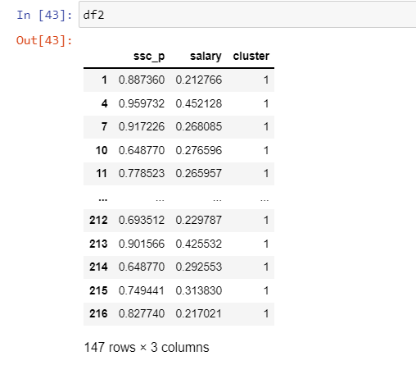
Case2: SSC_P(senior secondary percentage) and Salary
Data frame with cluster 0
Data frame with cluster 1

Slide 16
Case3: Status and aggerate School Percentage
Columns: Status and Aggerate School Percentage
Categorical to Numerical : Placement status first convert from categorical data to numerical data.

Slide 17
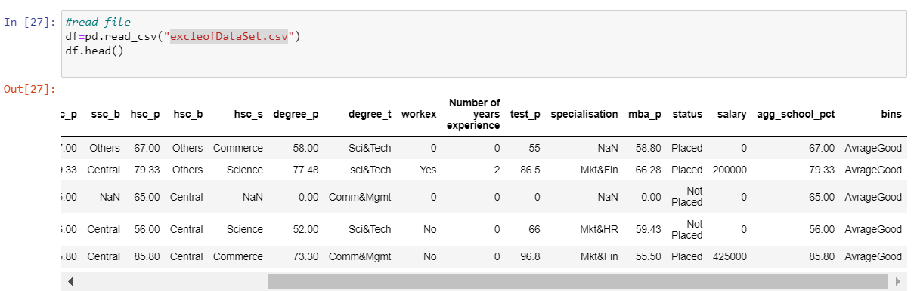
Case3: Status and aggerate School Percentage
Case 3
Read the file and display the data in dataframe
Categorical to Numerical : Placement status first convert from categorical data to numerical data.

Slide 18
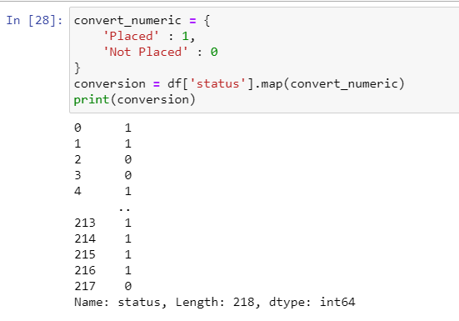
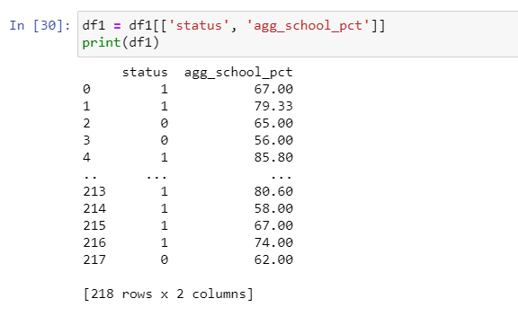
Case3: Status and aggerate School Percentage
Categorical to Numerical : Placement status first convert from categorical data to numerical data.
Columns: Status and Aggerate School Percentage

Slide 19
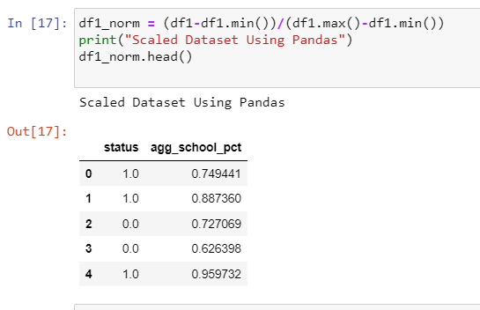
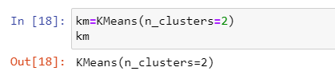
Case3: Status and aggerate School Percentage
Normalize the column values fir status and aggregate school percentage
Divide the clusters

Slide 20
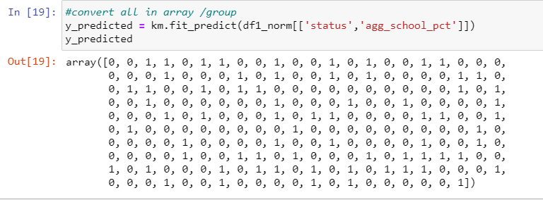
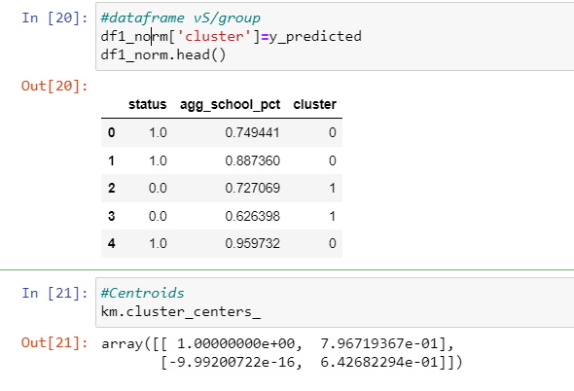
Case3: Status and aggerate School Percentage
Convert the column values to array for salary and aggregate school percentage
Display the clusters for each row values and diaply centroids

Slide 21
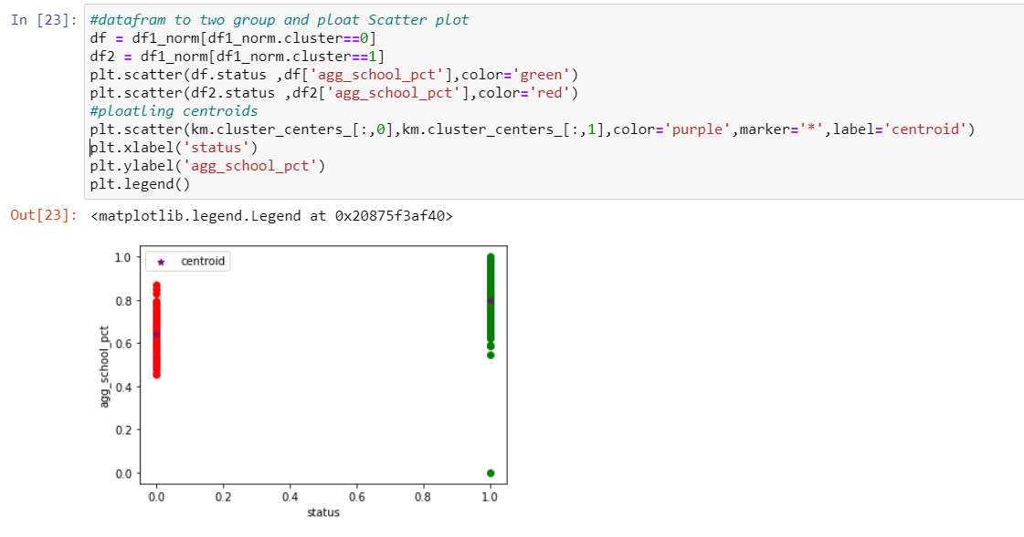
Case3: Status and aggerate School Percentage
.plot the data frames and centroids with the labels for x and Y

Slide 22
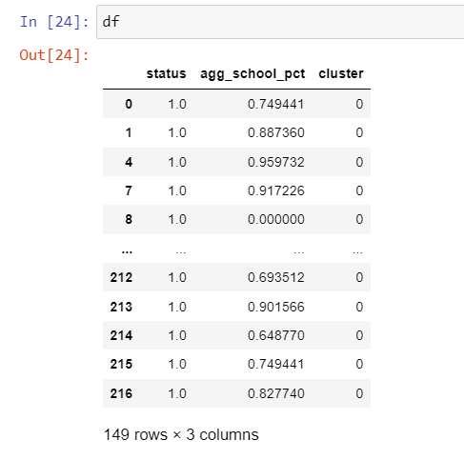
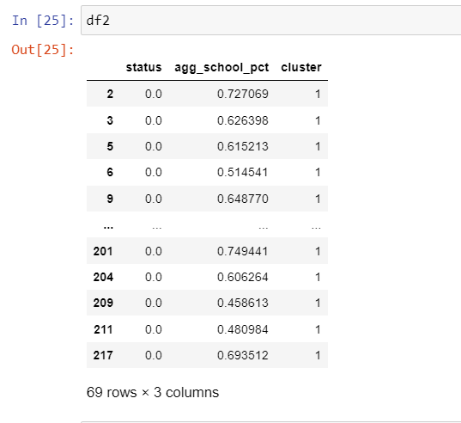
Case3: Status and aggerate School Percentage
Data frame data with cluster 1
Data frame data with cluster 0

Slide 23
Case3: Status and aggerate School Percentage
Columns: Status and Aggerate School Percentage
Categorical to Numerical : Placement status first convert from categorical data to numerical data.

Slide 24
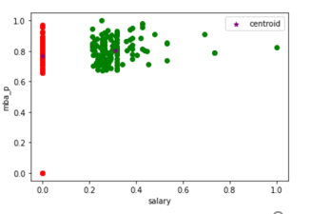
Outcomes
Case1: Salary and MBA Percentages
k mean Custer :2
Custer 1: Student who has not done MBA , many of them are not placed in campus selection
Custer 2: Student having 60 %to 80% are getting higher package.

Slide 25
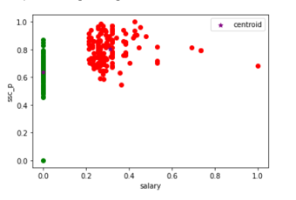
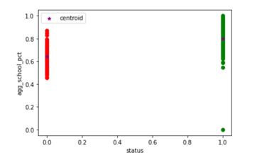
Outcomes
Case2: SSC_Precentage and Salary
K mean Custer:2
Custer 1: Student who has not done SSC , many of them are not placed in campus selection.
Custer 2: Student having 55 %to 80% are getting jobs
Case3:Aggregate_School _percentage and Salary
K mean Custer:2
Custer1: the student who are not places have 55% to 80 & agg school percent.
Custer 2 there are group of students who got placed , they got 55% to 100 % in school agg percentages

Slide 26
References
Data Set Collected
Kaggel
Tools/Software
Microsoft Word, Power Point, Excel
Jupiter Notebook, Python, Panda, MATLAB, NumPy,
Material
Internet, Course Book, Python.org, W3 School, Notes, YouTube (codebasics )
Other Helps
NA

Slide 27
THANK YOU
Team: The Data Scientist
Divya Dongala
Pragati Gupta

